Slide 1
HW3
FE & EDA Assignment
APANPS5420 Anomaly Detection
Zhenyu Wang

Slide 2
Part 1: Summary of “Determinants of Default in P2P Lending”
P2P lending involves individuals lending money to other individuals without the involvement of a financial institution.
Factors such as loan purpose, annual income, current housing situation, credit history, and indebtedness are associated with loan default in P2P lending.
The grade assigned by the P2P lending site is the most predictive factor of default.
The study emphasizes the importance of the information provided by P2P lending sites in reducing information asymmetry and aiding lenders in their decision-making process.
Individual investors should consider additional factors beyond interest rates when making lending decisions in P2P lending.

Slide 3
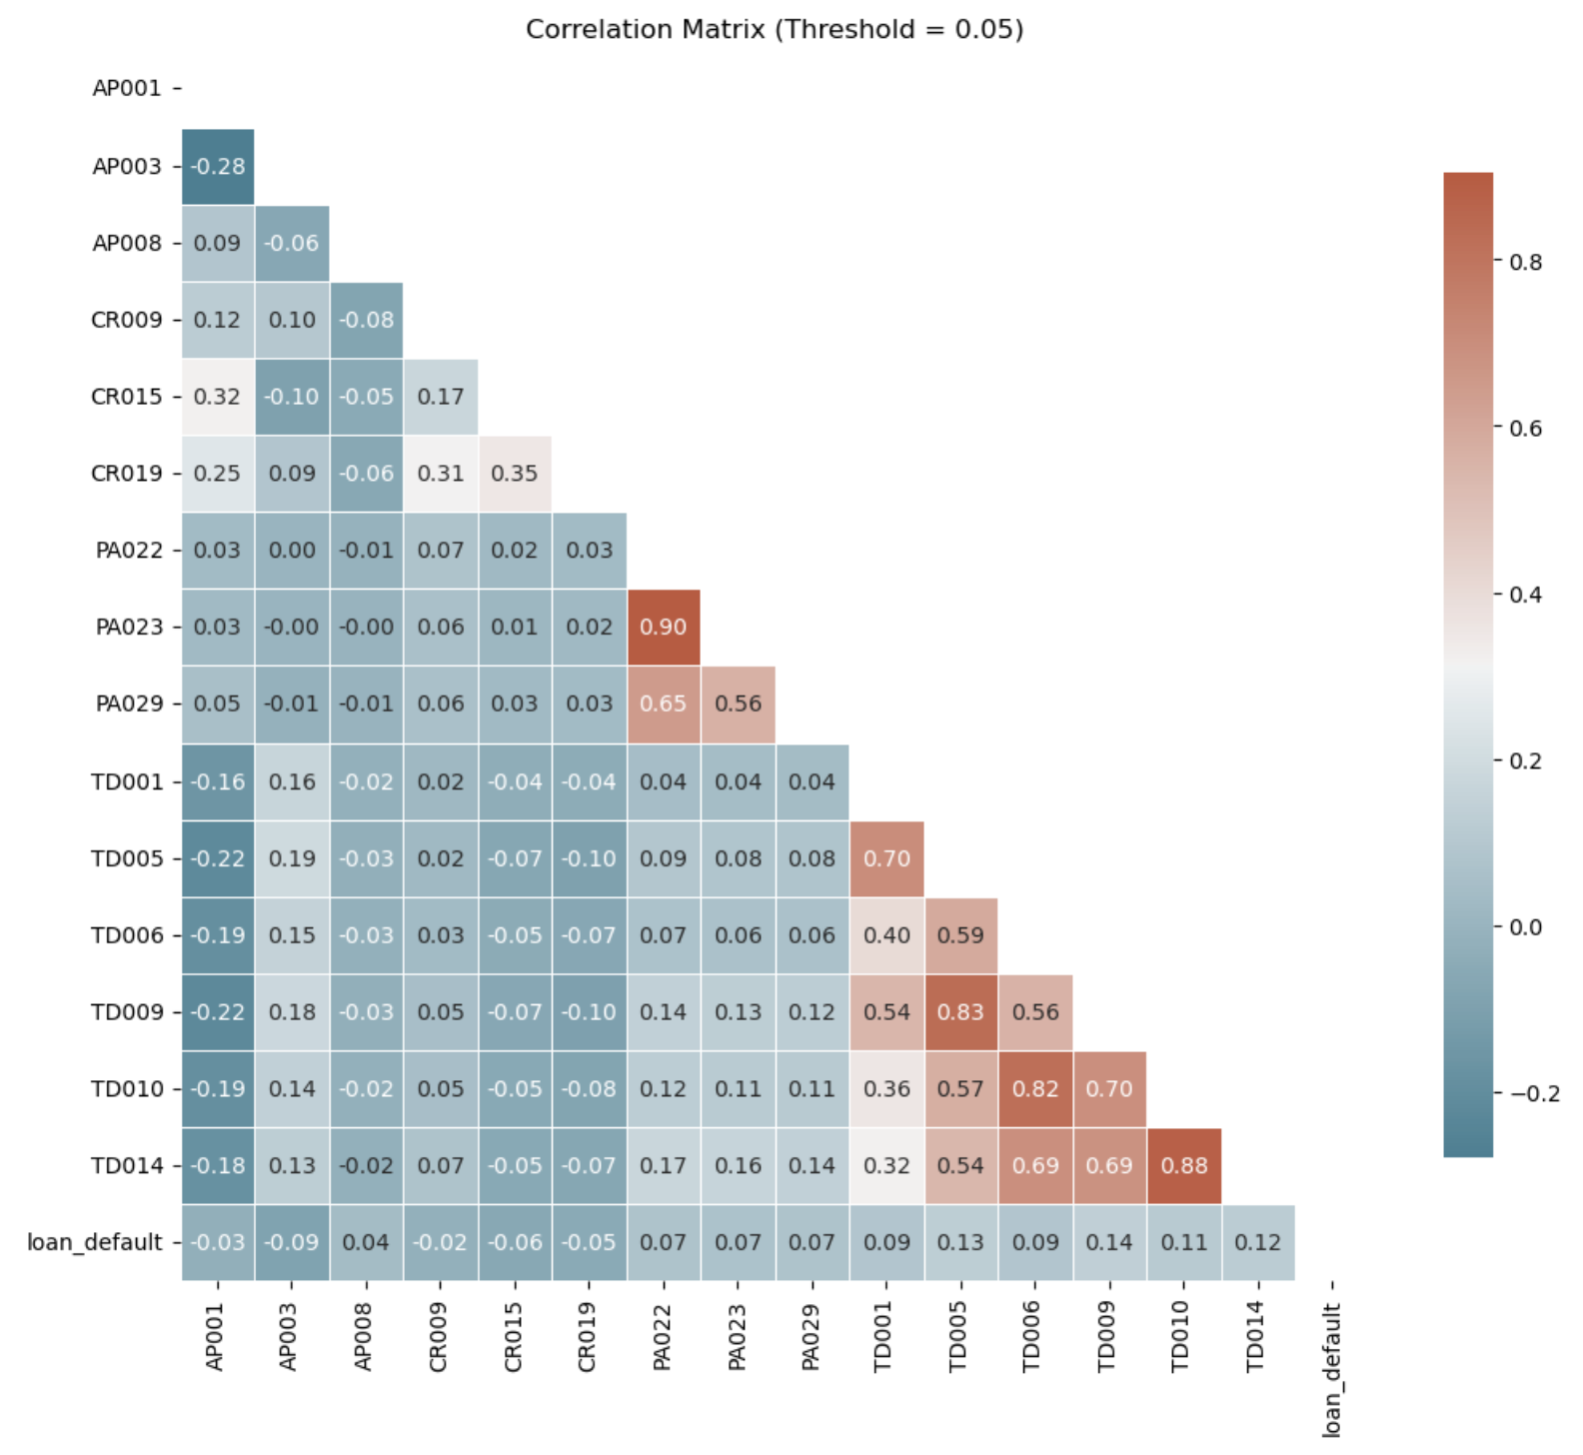
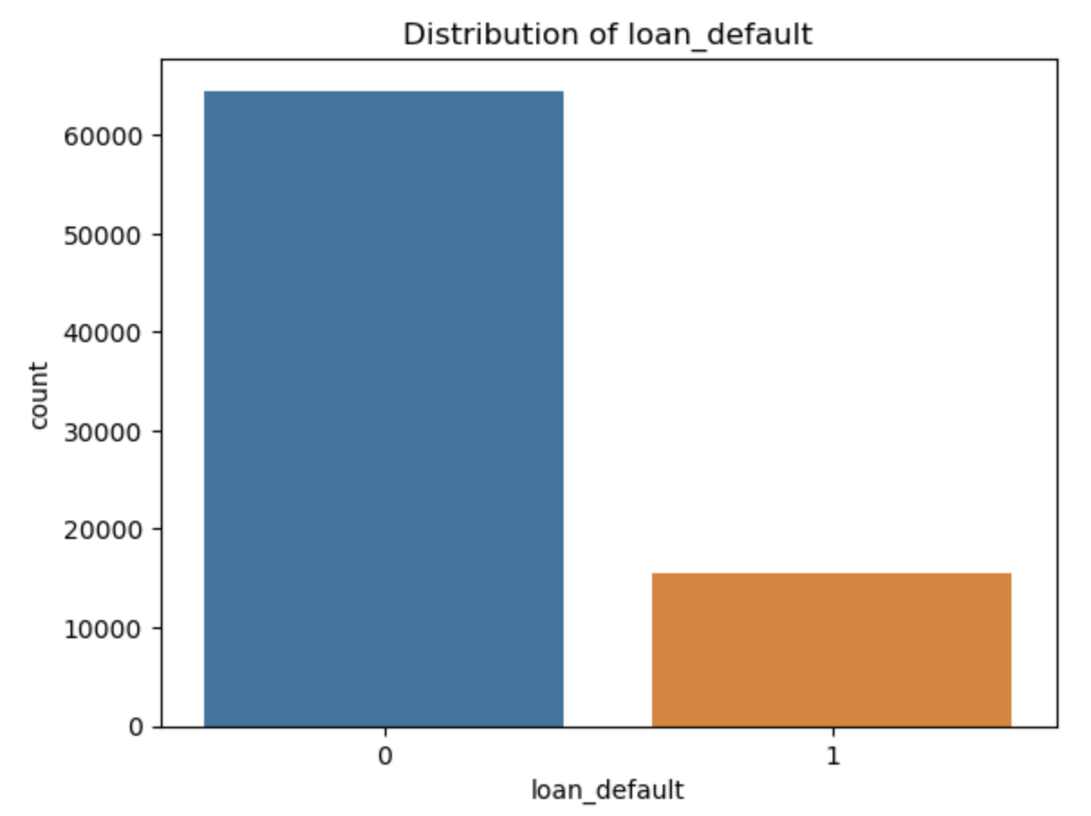
Part 2: Exhaustive EDA Summary

Slide 4
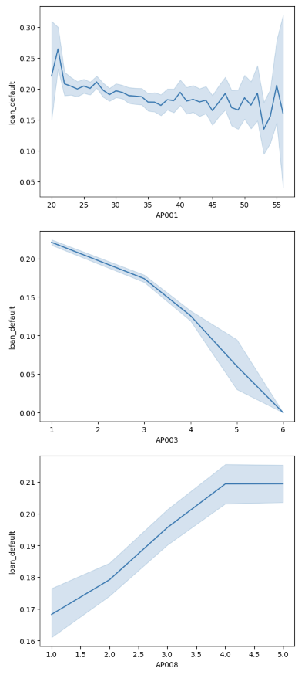
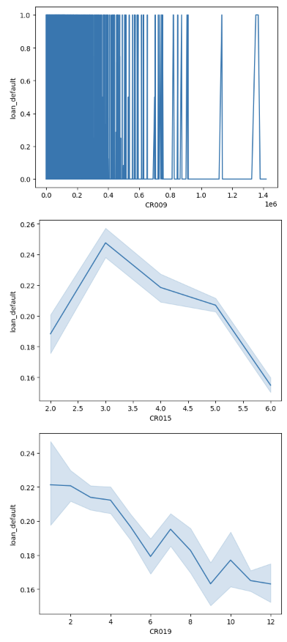
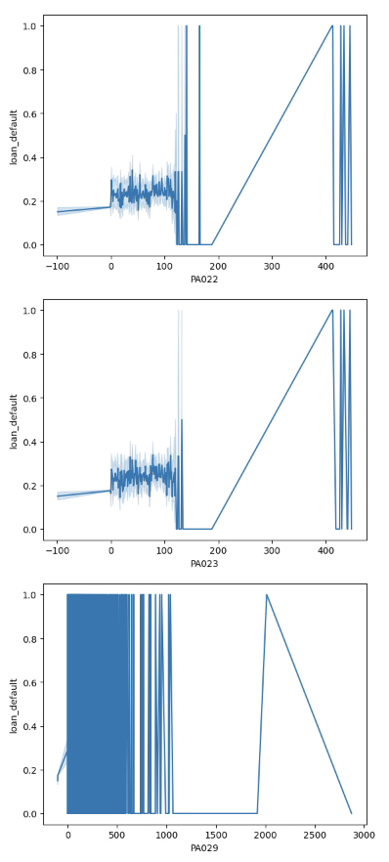
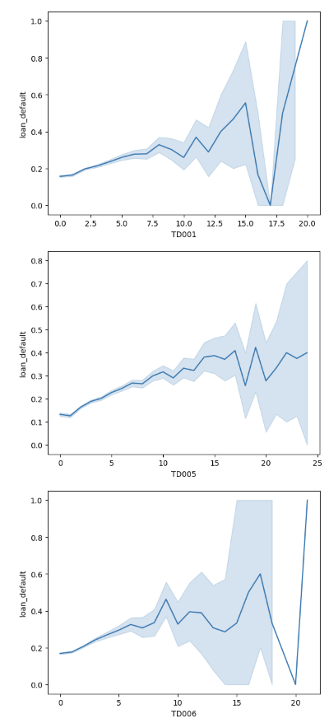
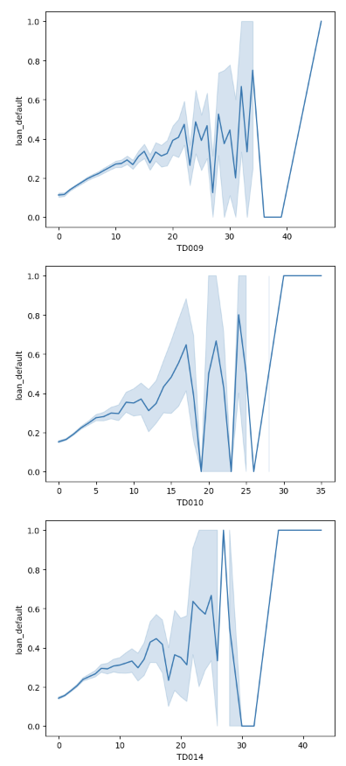
Part 2: Exhaustive EDA Summary

Slide 5
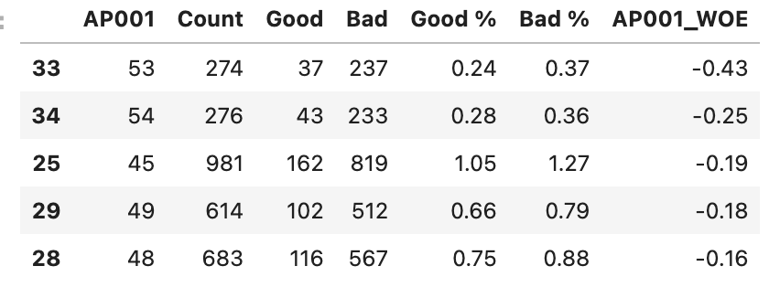
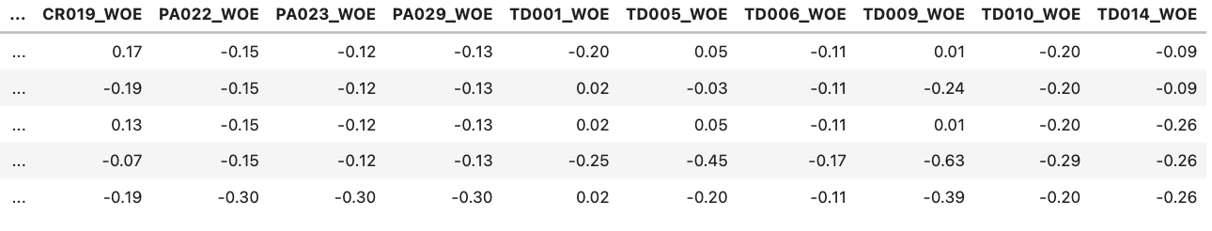
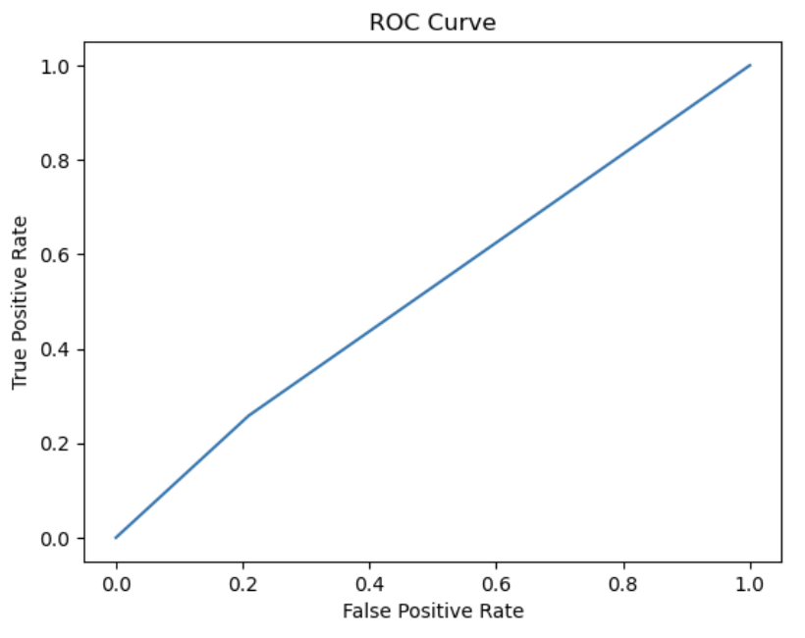
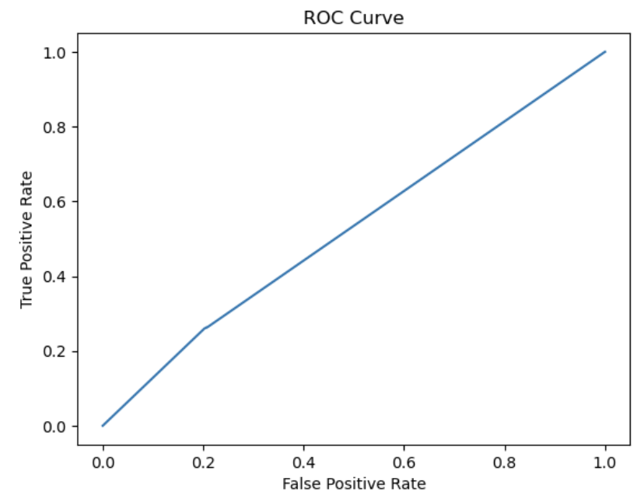
Part 3: WOE Transformation & Modelling
Original Dataset (Without Features - WOE Vars)
With Features (WOE Vars) Dataset

Slide 6
Thanks For Listening

